Slide 1

Customer Shopping Analysis
ANALYZING CUSTOMER SHOPPING TO INCREASE SALES
DONE BY : SUKESH PAVAN BITRAGUNTA
SUBMITTED TO : CHAOJIE WANG

Slide 2
Introduction
Customer shopping analysis enables a company to change its product based on its target customers from various customer categories.
Instead of paying money to promote a new product to every client in the firm's database.
Company may determine which customer group is most likely to purchase the product and then market the product just to that segment.

Slide 3

Objective & Data
To understand the shopping analysis of the consumer and segregate them into groups.
This grouping will help us to promote the products that will make more sales and promote the company.
The dataset was taken from Kaggle, and the entries are from 2014, It has 2240 rows and 29 columns

Slide 4
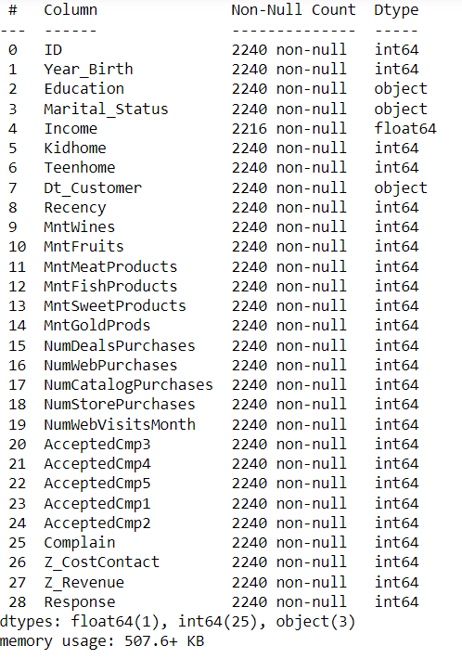
Data Pre-processing
In The dataset there are 29 columns such as customer_id , dt_customer, Income, Martial_status and other.
Removed null values and outliers from the dataset using boxplot and added new attributes to column
Such as total amount spent, number of campaigns accepted by customers and other.

Slide 5
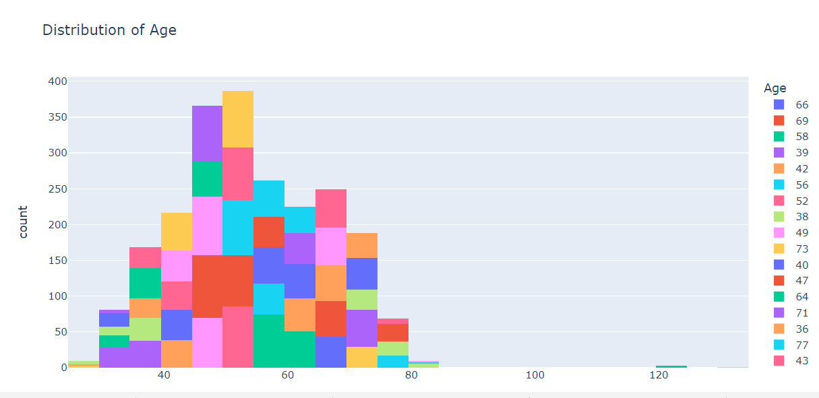
EDA(Exploratory Data Analysis)
SOME OF THE INSIGHTS THAT I OBSERVED WHILE PREFORMING EDA

Slide 6
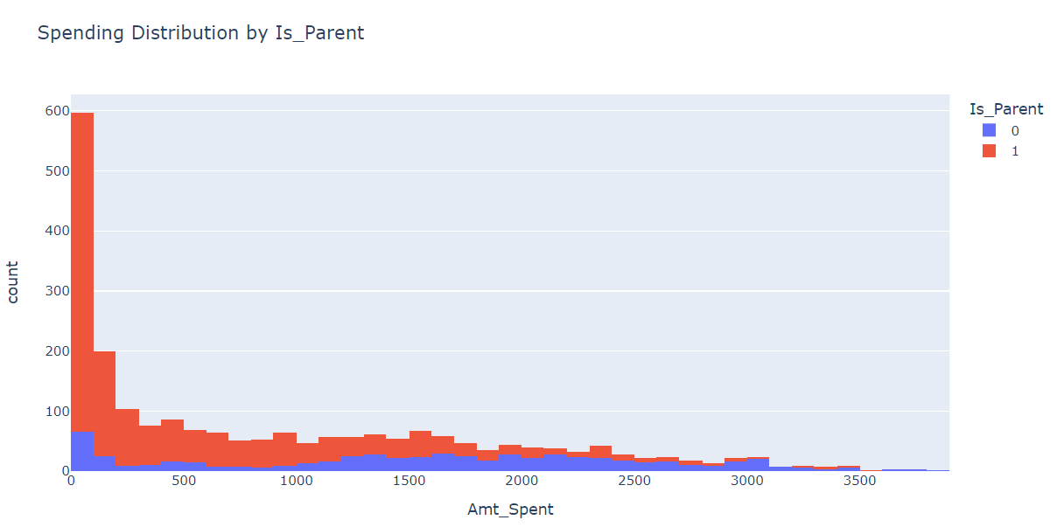
EDA
In this graph we can see the total amount spent by a parent p and a single person.

Slide 7
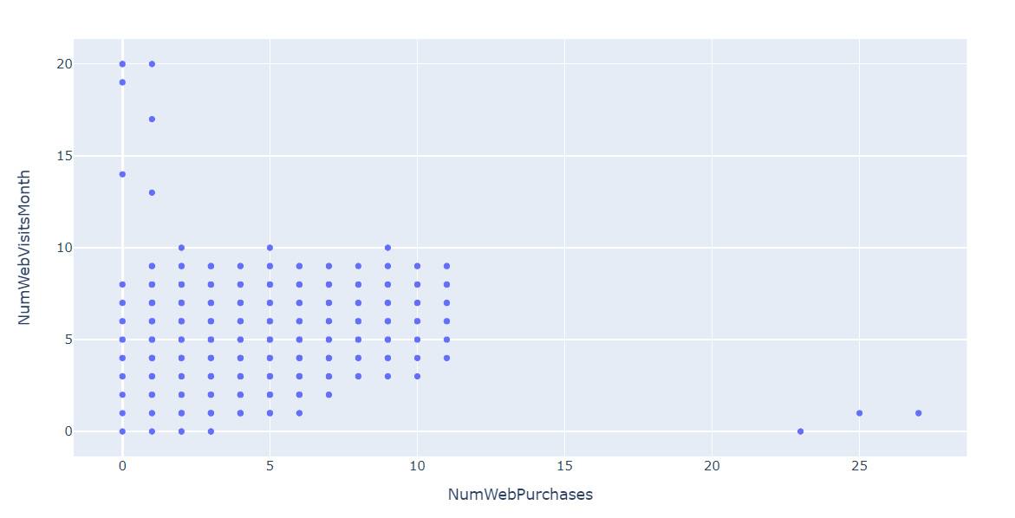
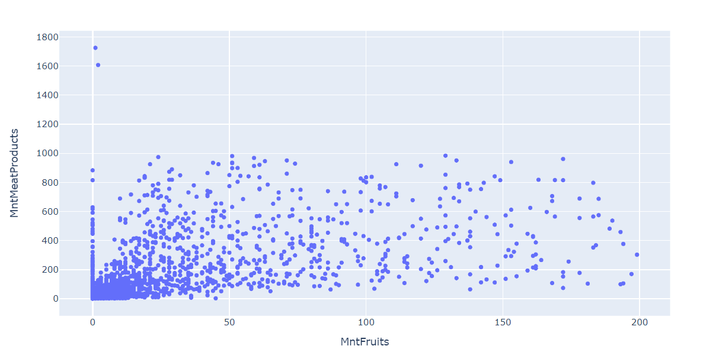
EDA

Slide 8
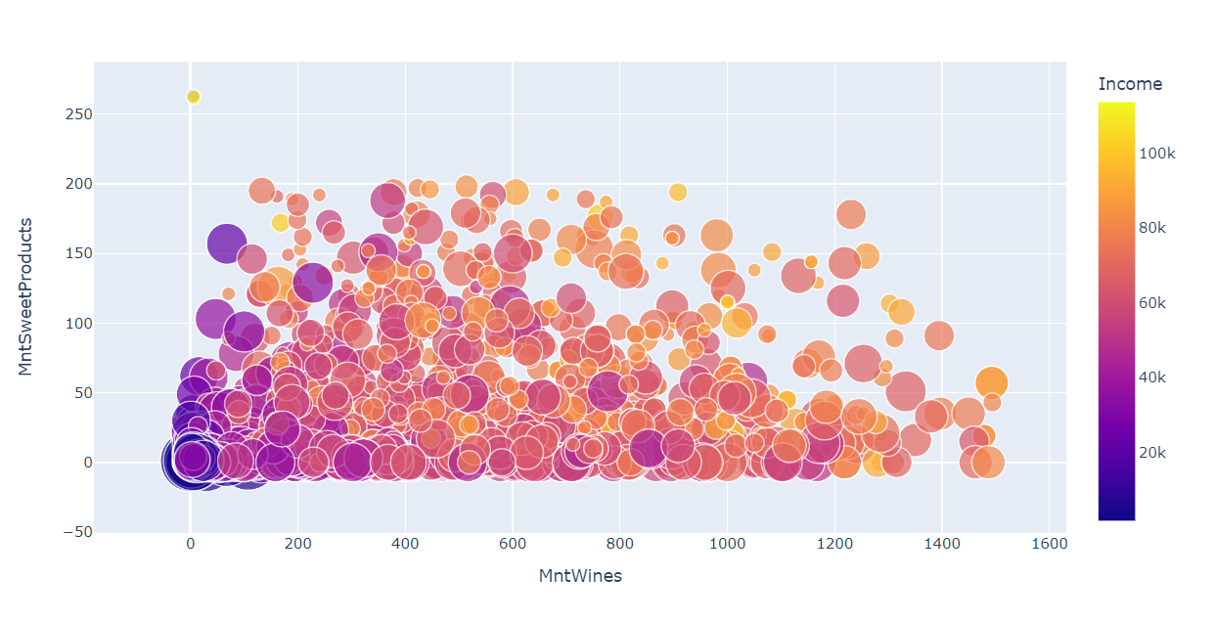

Slide 9
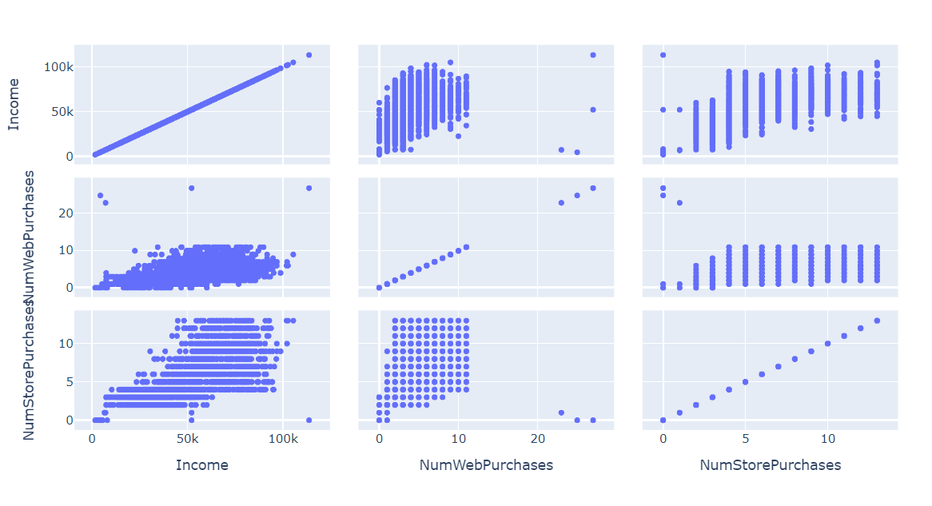

Slide 10
Machine learning
Two model were used one is K-means clustering and the other one is Hierarchical clustering.
K means clustering is used for grouping the dataset. To perform the model every attribute should be a continuous variable.
One hot encoding was used to convert the categorical variables to format that can be helpful to machine learning algorithms.

Slide 11
Machine Learning
The next step would be determining the value of k, There are two methods two perform this,
The silhouette score and plot are used to evaluate the quality of a clustering solution produced by the k-means algorithm. The highest and closest point to one is considered the optimal number of clusters.
The other one is elbow method, In the Elbow method, we are actually varying the number of clusters (K) from 1 – 10. For each value of K, we are calculating Within-Cluster Sum of Square.

Slide 12
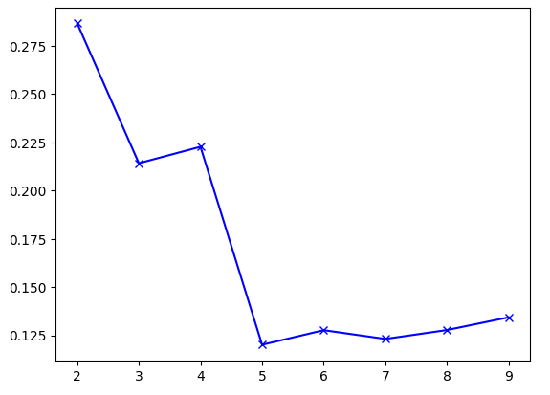
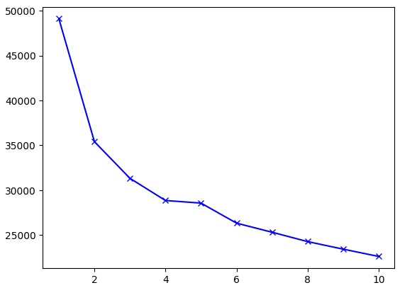
Machine Learning
SILHOUETTE SCORE
ELBOW METHOD

Slide 13
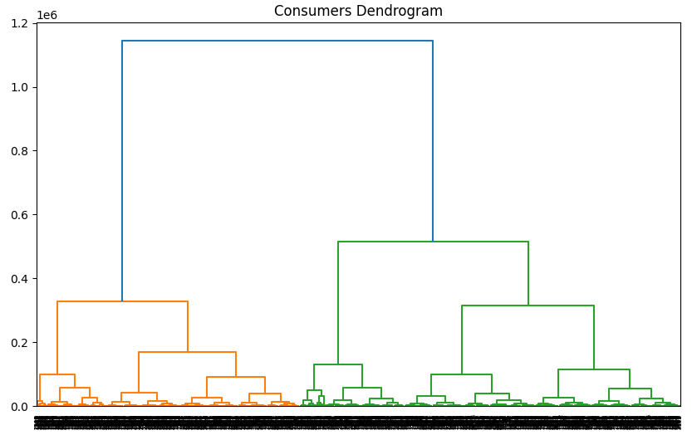
Hierarchal Clustering
Hierarchical clustering groups similar objects into a dendrogram. It merges similar clusters iteratively, starting with each data point as a separate cluster.
To get the number of clusters for hierarchical clustering, we make use a concept called Dendrogram.

Slide 14
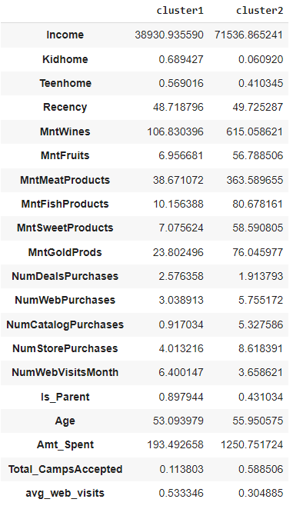
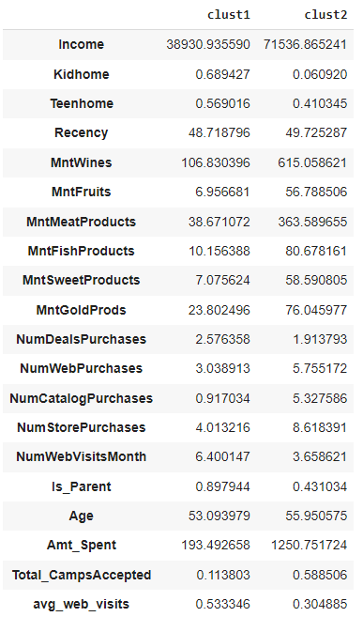
Cluster Profiling
These charts provide the mean of each attribute after clustering
The left chart is the result of Keans clustering and the right one is hierarchical clustering
By observing the charts, we can conclude the clustering done by two algorithms model are almost identical.
Cluster1 | Cluster2 | Clust1 | Clust2
1362 | 872 | 1320 | 912

Slide 15
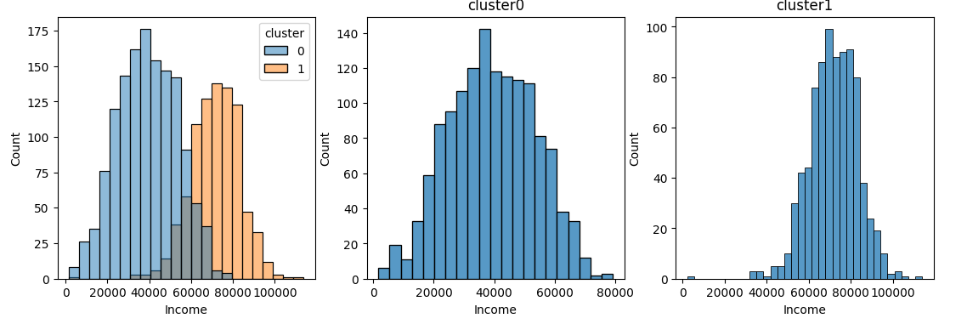
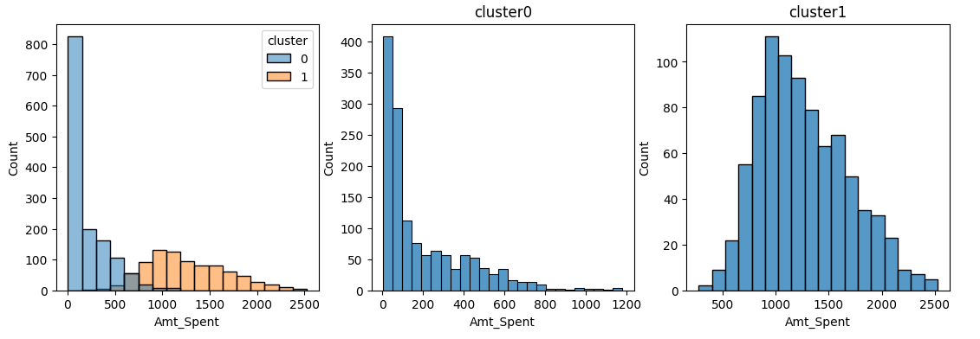
Cluster Profiling
CUSTOMER INCOME
TOTAL AMOUNT SPENT BY CUSTOMER

Slide 16
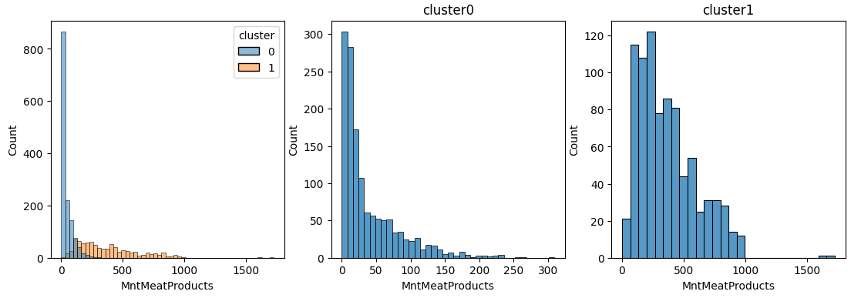
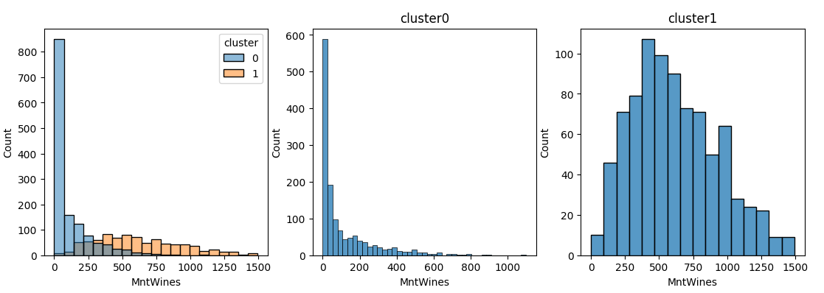
Cluster Profiling
AMOUNT SPENT ON MEAT PRODUCTS
AMOUNT SPENT ON WINES

Slide 17
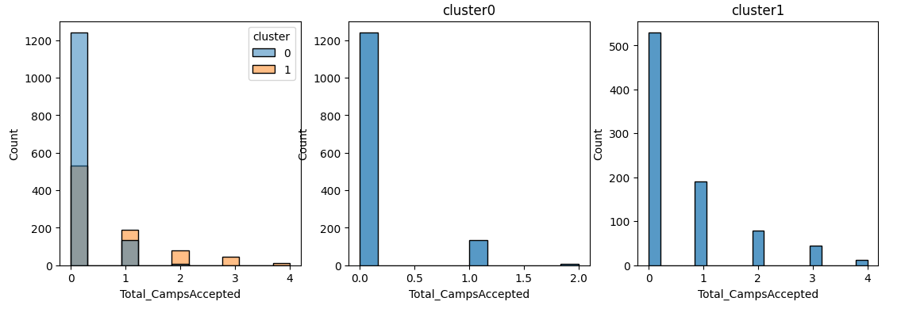
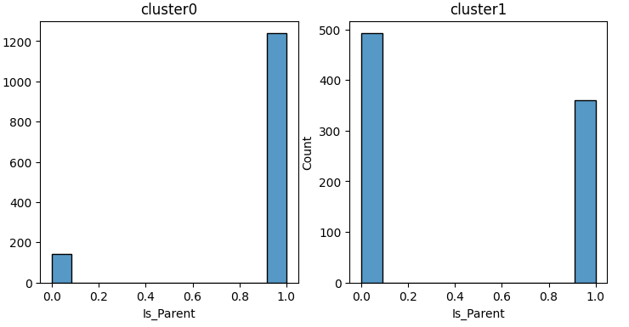
Cluster Profiling
TOTAL CAMPAIGNS ACCEPTED BY CUSTOMER
PARENTS DISTRIBUTION IN CLUSTERS

Slide 18
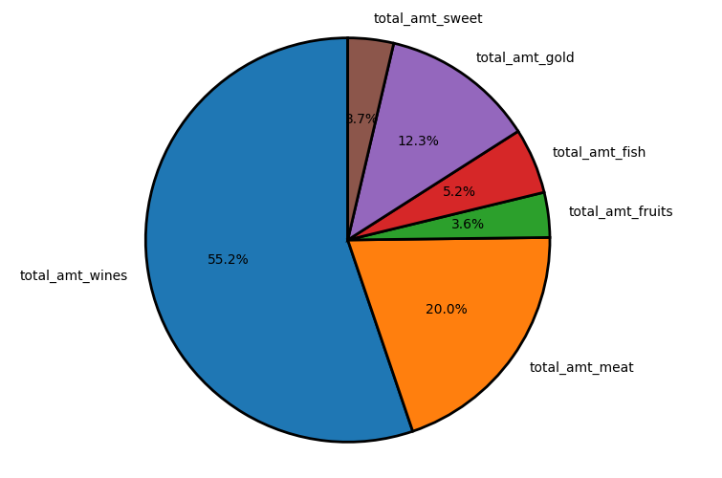
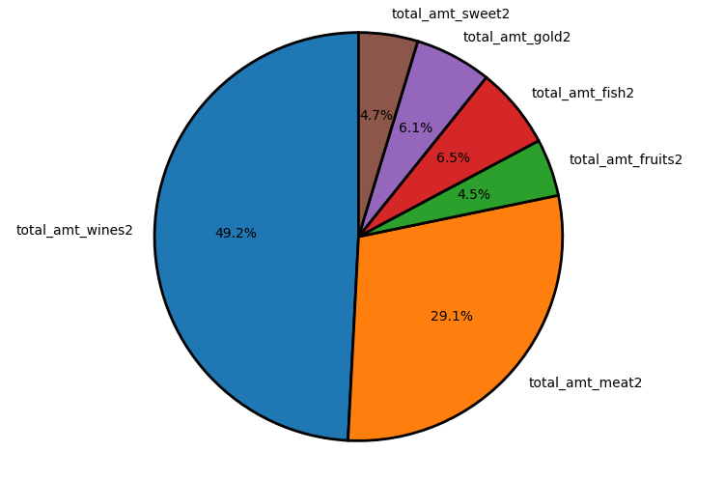
Conclusion
TOTAL REVENUE GENERATED BY PRODUCTS IN EACH CLUSTER
TOTAL REVENUE GENERATED BY PRODUCTS IN CLUSTER2

Slide 19
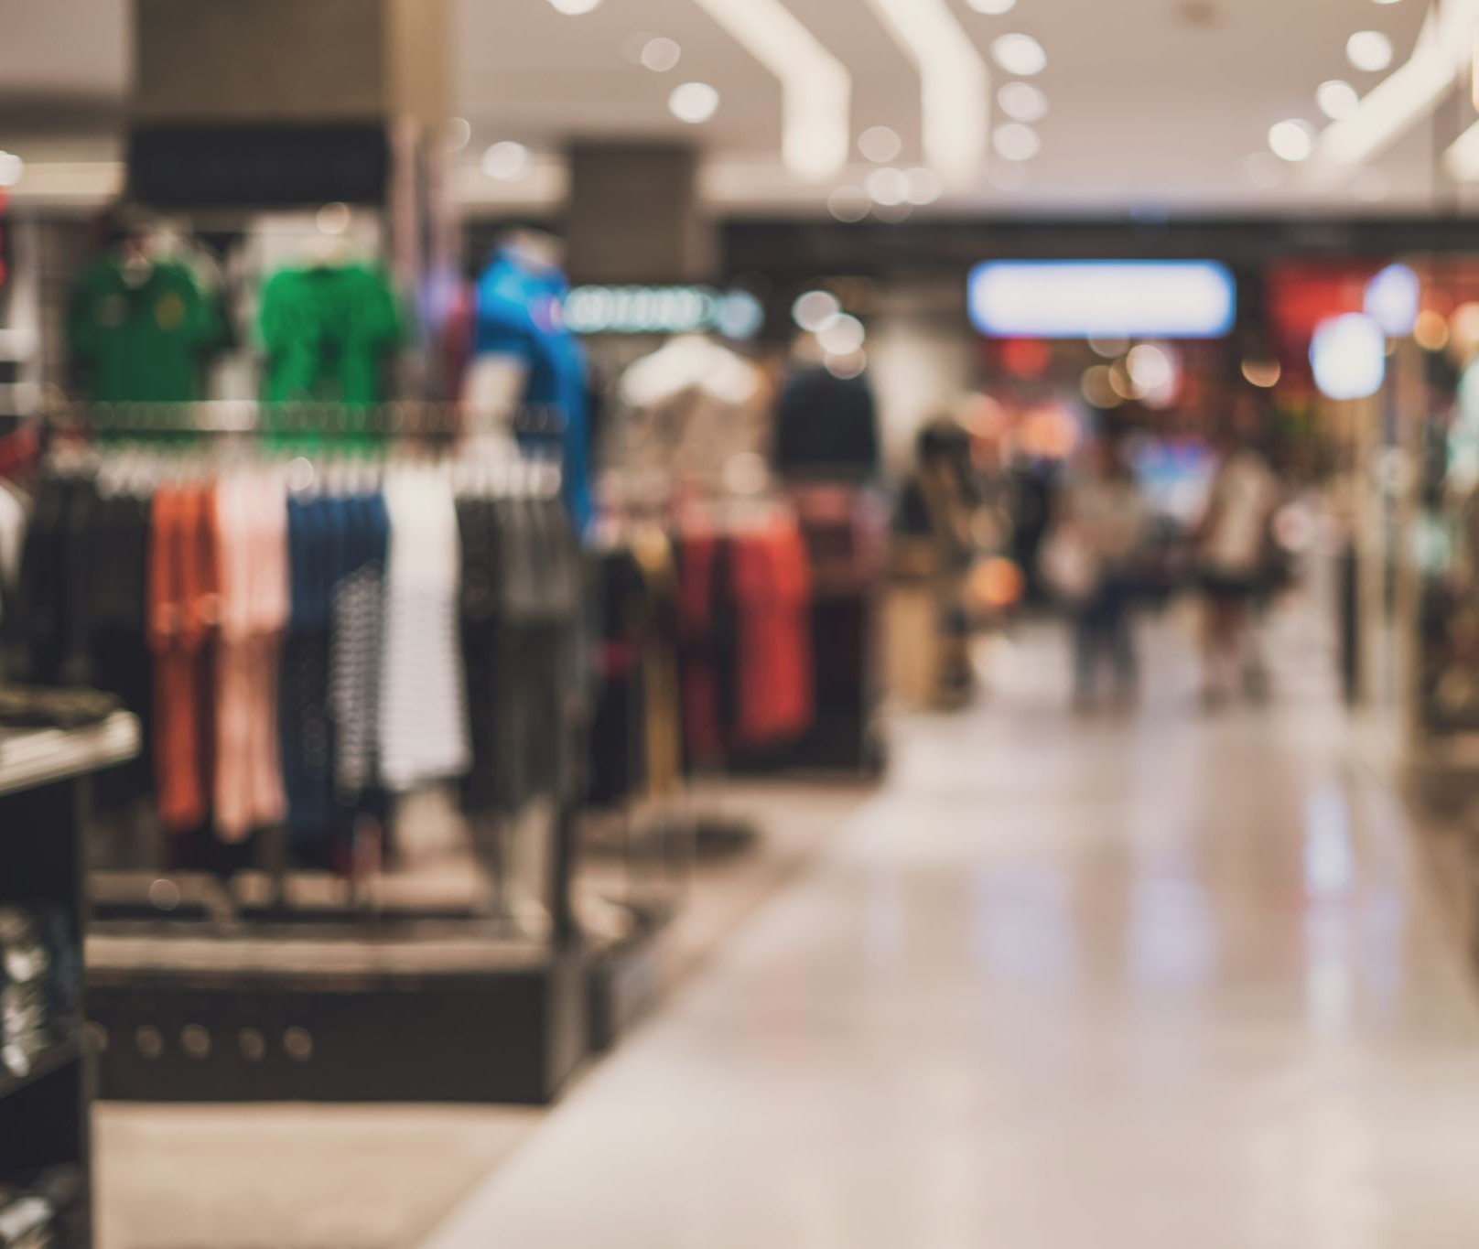
Conclusion
The insights that are observed after clustering are
Wines are the most consumed product followed by meat of the company.
Also customers that are grouped in cluster1 have accepted more campaigns
In cluster0 we have more parent compared to other cluster
This will helps us to promote the products that the customers are going to buy and it will also help us save on promotion of products.

Slide 20
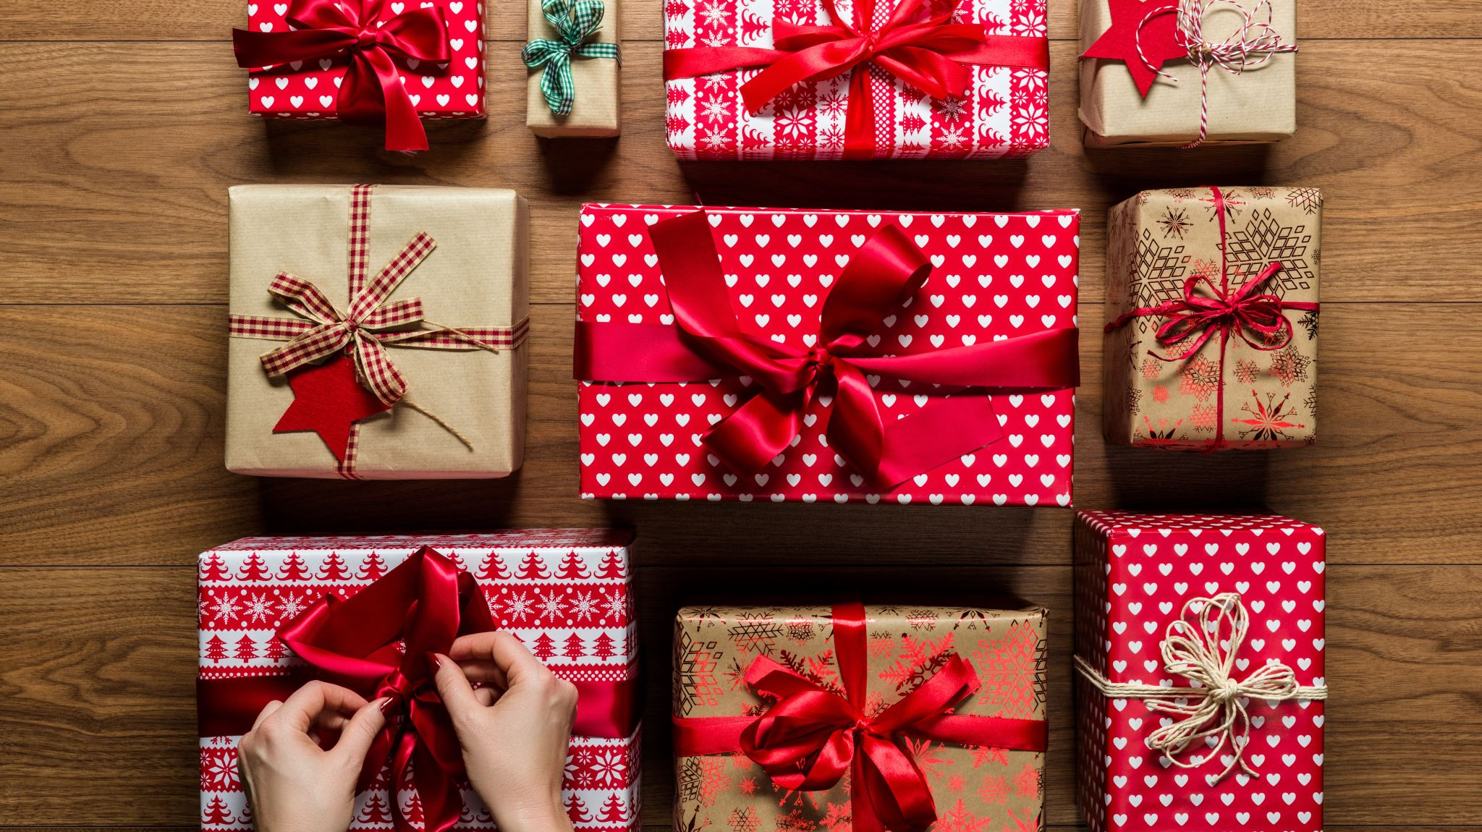
Thank You

